Slide 1
SRM UNIVERSITY, ANDHRA PRADESH
Introduction to Programming Using C Project Report on
“ Stone, Paper, Scissors Game ”
submitted in partial fulfillment for the award of the degree in
BACHELOR OF TECHNOLOGY
IN
COMPUTER SCIENCE AND ENGINEERING
Submitted by
Jenil Padshala | AP21110010064
Ponvitha Nerusu | AP21110010065
Naga Hareesh Beecha | AP21110010839
Udaya Sruthi Saleti | AP21110011171
Under the guidance of
Mrs.Vidya V

Slide 2
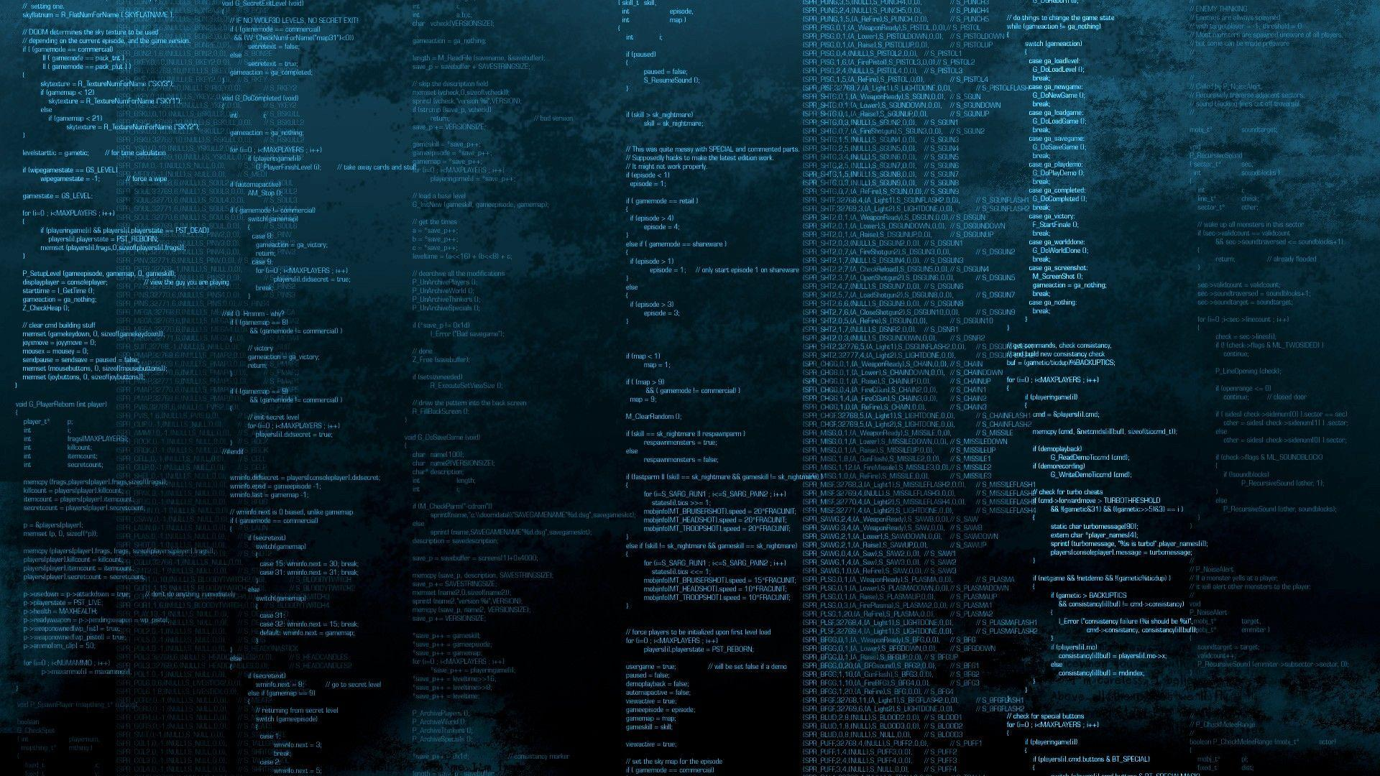
Abstract
The project is a game to be played between the computer and the user, developed using C language. The ‘Stone, Paper, Scissors Game’ Project that we will develop will have following key features:
Run the program for the number of rounds the user wants to play using a for loop .
Generate a random response for the computer using rand() function in C language .
Declare the winner of each round using ‘ if statements ’.
Count the total wins for both the player and computer .
After all the rounds are completed , display the overall winner .

Slide 3
Chapter-1
Introduction
Rock, Paper, Scissors is a childhood game that we intend to program and create for computers. Our project should work as follows:
1)When the program begins, the user is asked for the number of rounds that he wants to play. The source code is looped for that many times.
2)Next, a random number in the range of 0 through 2 is generated using the rand() function. If the number is 0, then the computer has chosen rock. If the number is 1, then the computer has chosen paper. If the number is 3, then the computer has chosen scissors.
3)Then, the user enters his or her choice, i.e., 0 for rock, 1 for paper and 2 for scissors.
4)The computer’s choice is displayed.
5)A winner for the round is selected according to the following rules:
If one player chooses rock and the other player chooses scissors, the rock wins. (The rock smashes the scissors.)
If one player chooses scissors and the other player chooses paper, the scissors wins.(Scissors cuts paper.)

Slide 4
If one player chooses paper and the other player chooses rock, then paper wins. (Paper wraps rock.)
If both players make the same choice, it's a draw.
After all the rounds are over, the player with the most wins is declared the winner of the entire game.

Slide 5
Chapter-2
Objective
The objective of our project is to develop a fun game to play on computer. Using our knowledge of C language, we are trying to create the rock, paper, scissors hand game that we played in our childhood.

Slide 6
Chapter-3
System Requirement Specification
SOFTWARE REQUIREMENTS:
Language used: C
Operating System: Windows 7
HARDWARE REQUIREMENTS:
Hard Disk: 512 GB
Processor: Intel Core i3

